Slide 1
HEB Social Hub
The social networks opportunity

Slide 2
Integration to enable and leverage social data
  Social network provide much more value than the ability to send information to your customer.
  They are a pool of information waiting for your tap into.
    Trends
    Sentiment
    Influence
  The challenge is to easily access and get visibility in that data, then react on it.

Slide 3
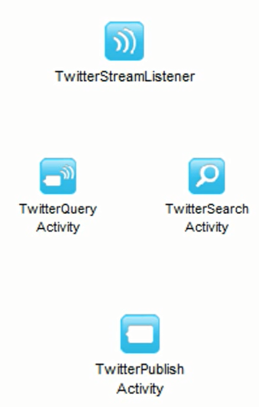
Plugin for Twitter
  Subscribe to twitter data in real time.
  Abstract twitter API to make the data available
  Send data to twitter

Slide 4
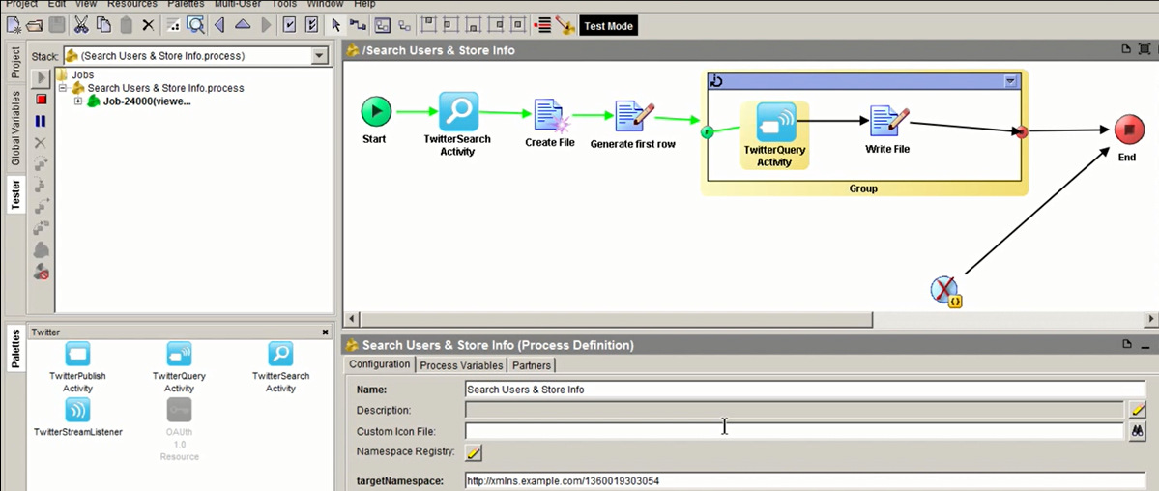
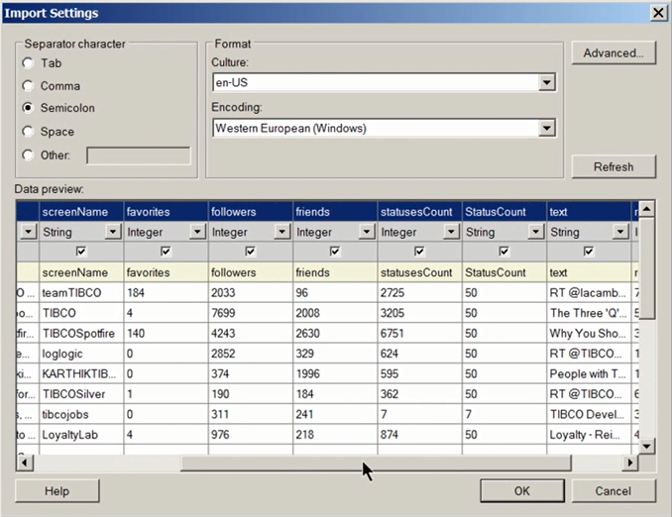
TIBCO Businessworks + Twitter

Slide 5
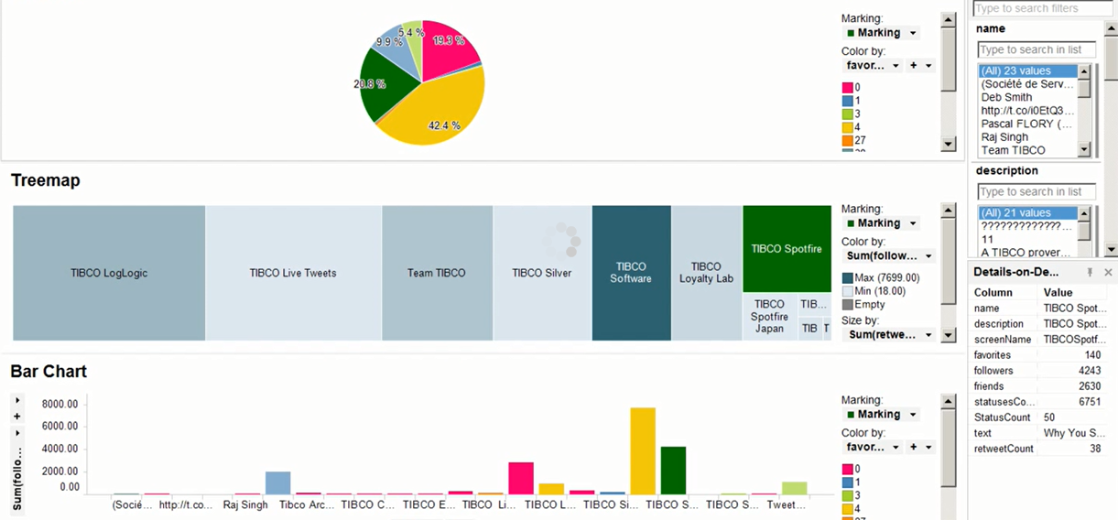
Dashboard

